Slide 1
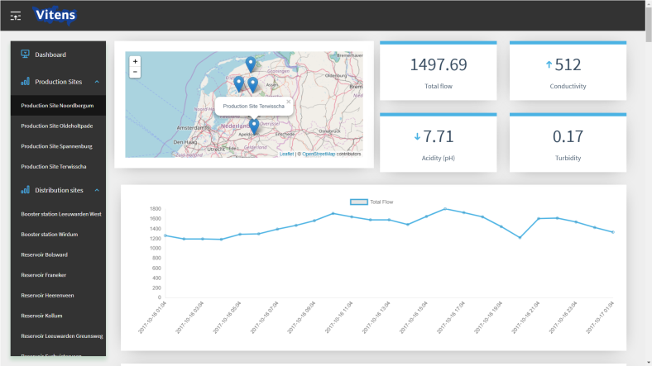
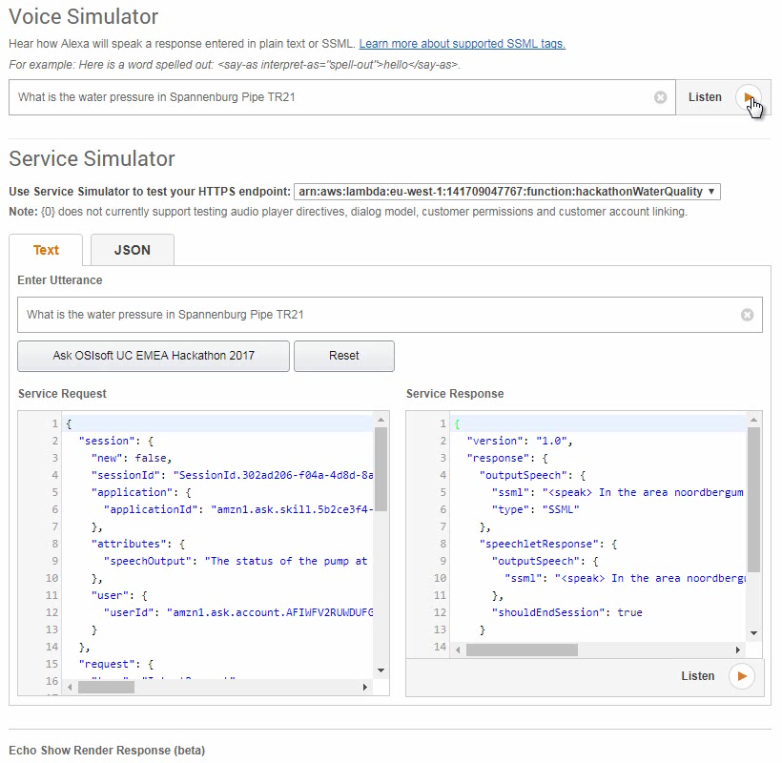
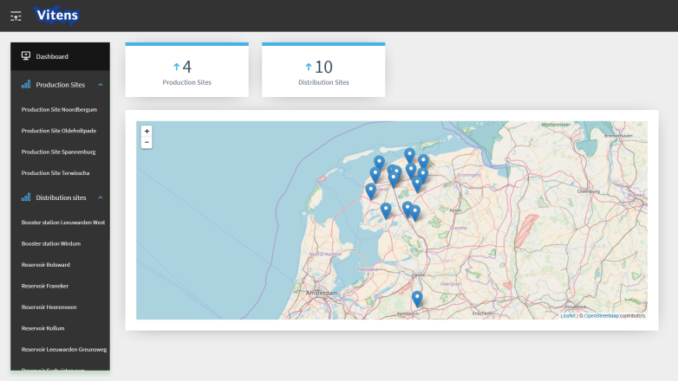
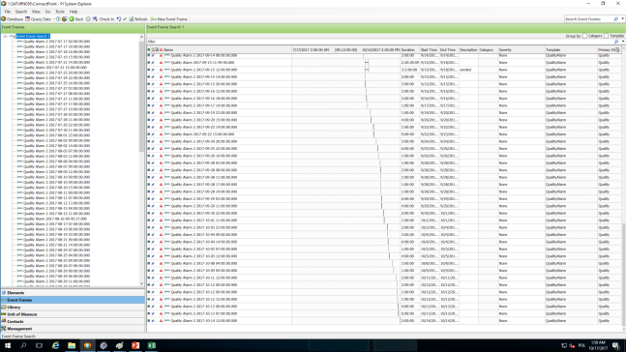
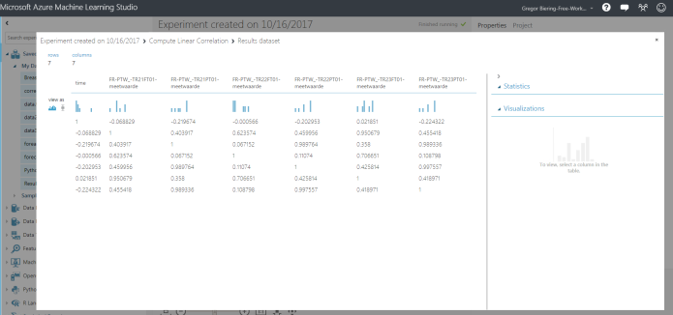
OSIsoft EMEA 2017 Hackathon event

Slide 2
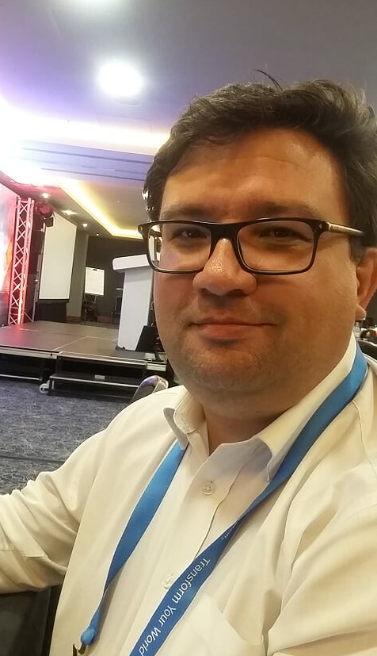
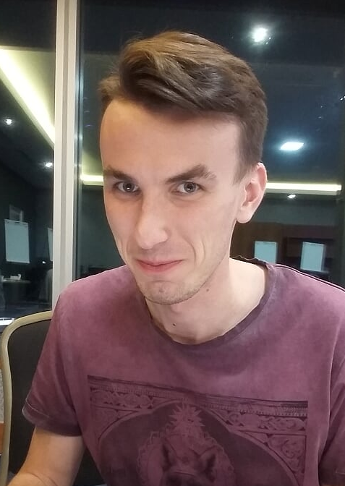
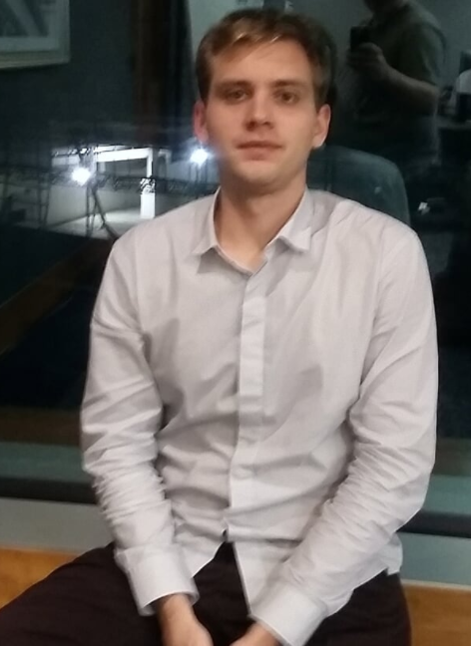
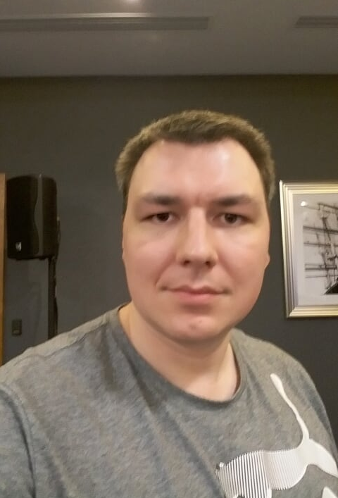
OSIsoft EMEA 2017 Hackathon event
„Objects on the presentation might look older than it appear“

Slide 3


Who are we?
Marek
Data Plumber
Jakub
Coder
Alexa
„her“
Przemyslaw
Coder
Gregor
The other

Slide 4



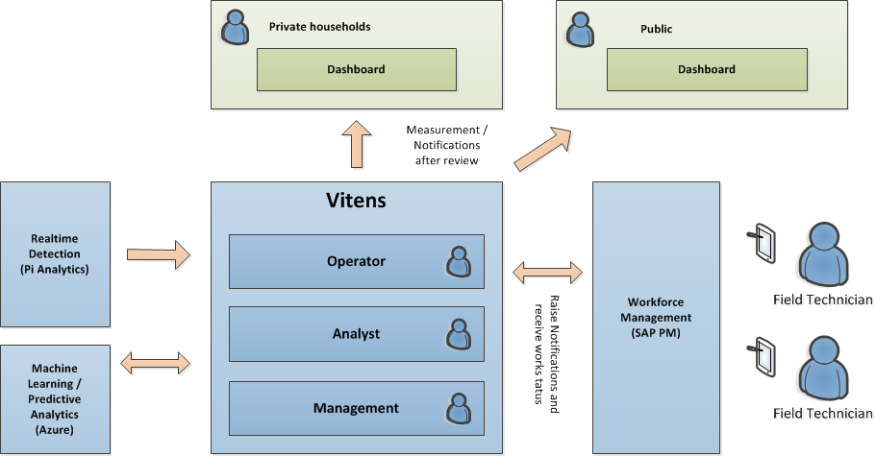
The challenge
Provide our of their future
A connected system that combines realtime data, detects anomalies and provide this to the right person to enable the right action.

Slide 5
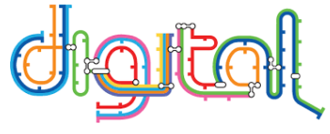
Provide our of their future
When the data indicates an issue that can cause a problem, it is assigned to the right work force and affected parties are notified if required.
Interventions are performed to resolve the issue.
Analytics in real time identify anomalies. Machine learning analytics predicts by correlating signals and past experience
Solutions are recorded. Outage and incidents are prevented and private households dissatisfaction eliminated
Data is acquired and transmitted to a central location

Slide 6

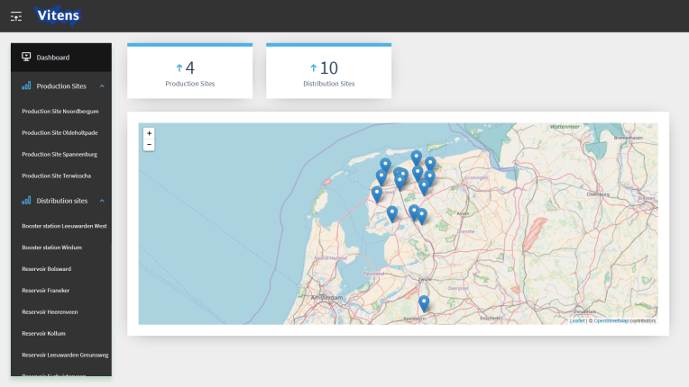

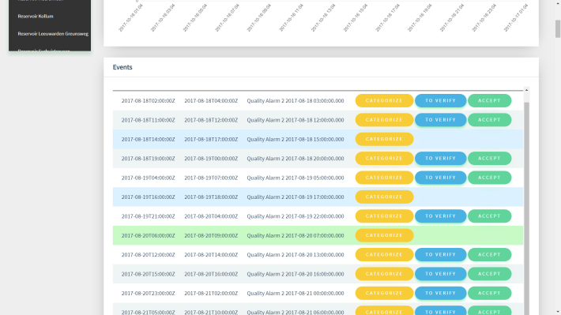

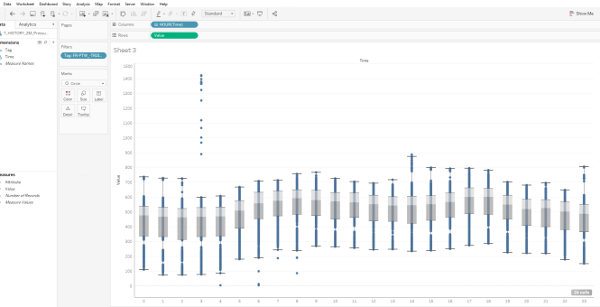
What we did

Slide 7
Used technologies
PI AssetFramework
Analysis
EventFrames
Webtechnologies
PI Web API
Realtime data (channels/websockets)
Batch queries
EventFrames (fetch and acknowledge)
Vue.js + Vuestic
Look and feel
Chart.js
Charting total flows
Leaflet.js + OpenStreetMaps
Displaying location of sites
Data Analytics
Tableau Desktop
Microsoft Azure Machine Learning Studio
SQL
PI OLEDB
Extended Userexperience
Alexa
Alexa Skills Kit
AWS Lambda Function (Node.js)

Slide 8
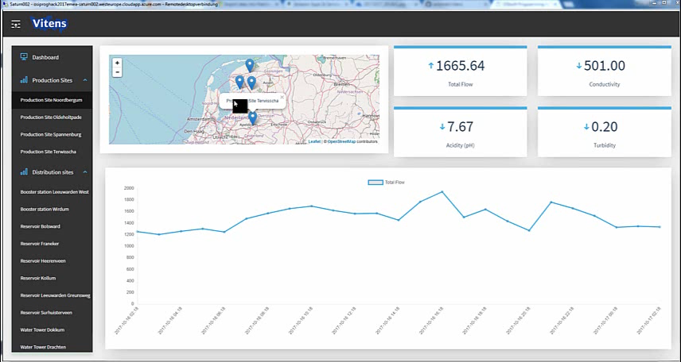
Dashboard

Slide 9
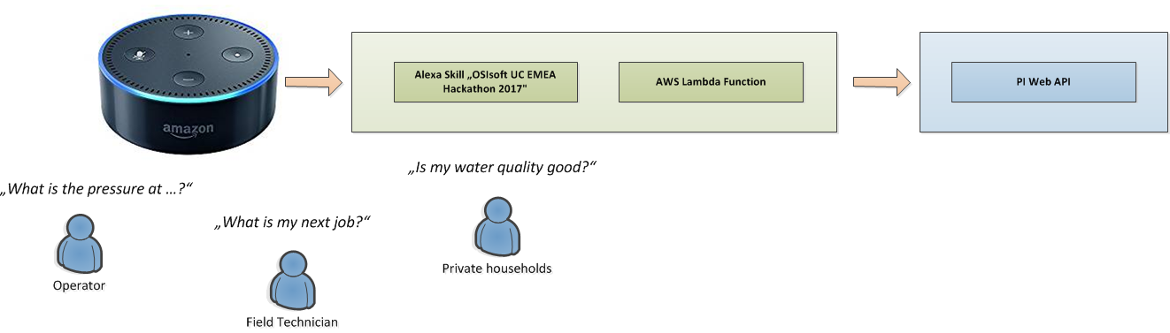
Alexa
A connected system that provides a new way to interact with the system

Slide 10
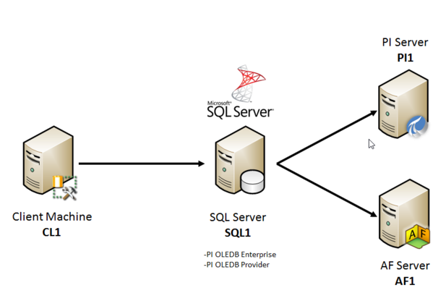
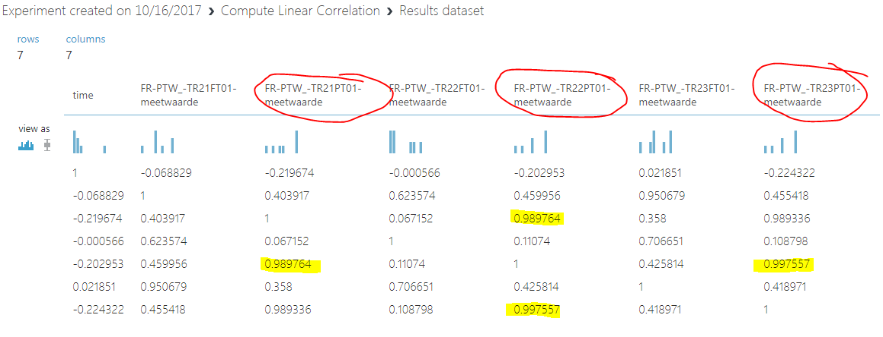
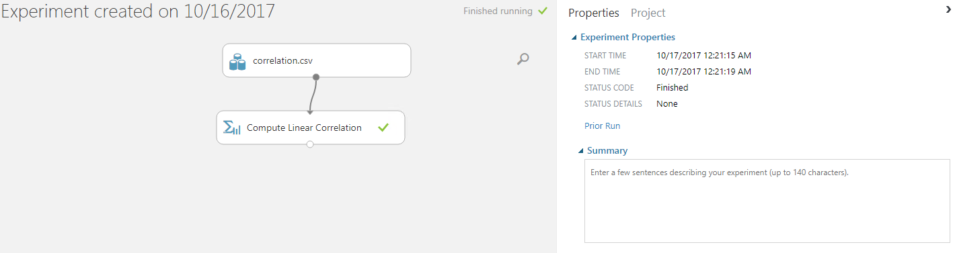
Data Analytics (Cloud)
Using data extracts via PI OLEDB. Visualizing the data with Tableau or experimenting with Microsoft Azure Machine Learning Studio by apply existing algorithms.

Slide 11

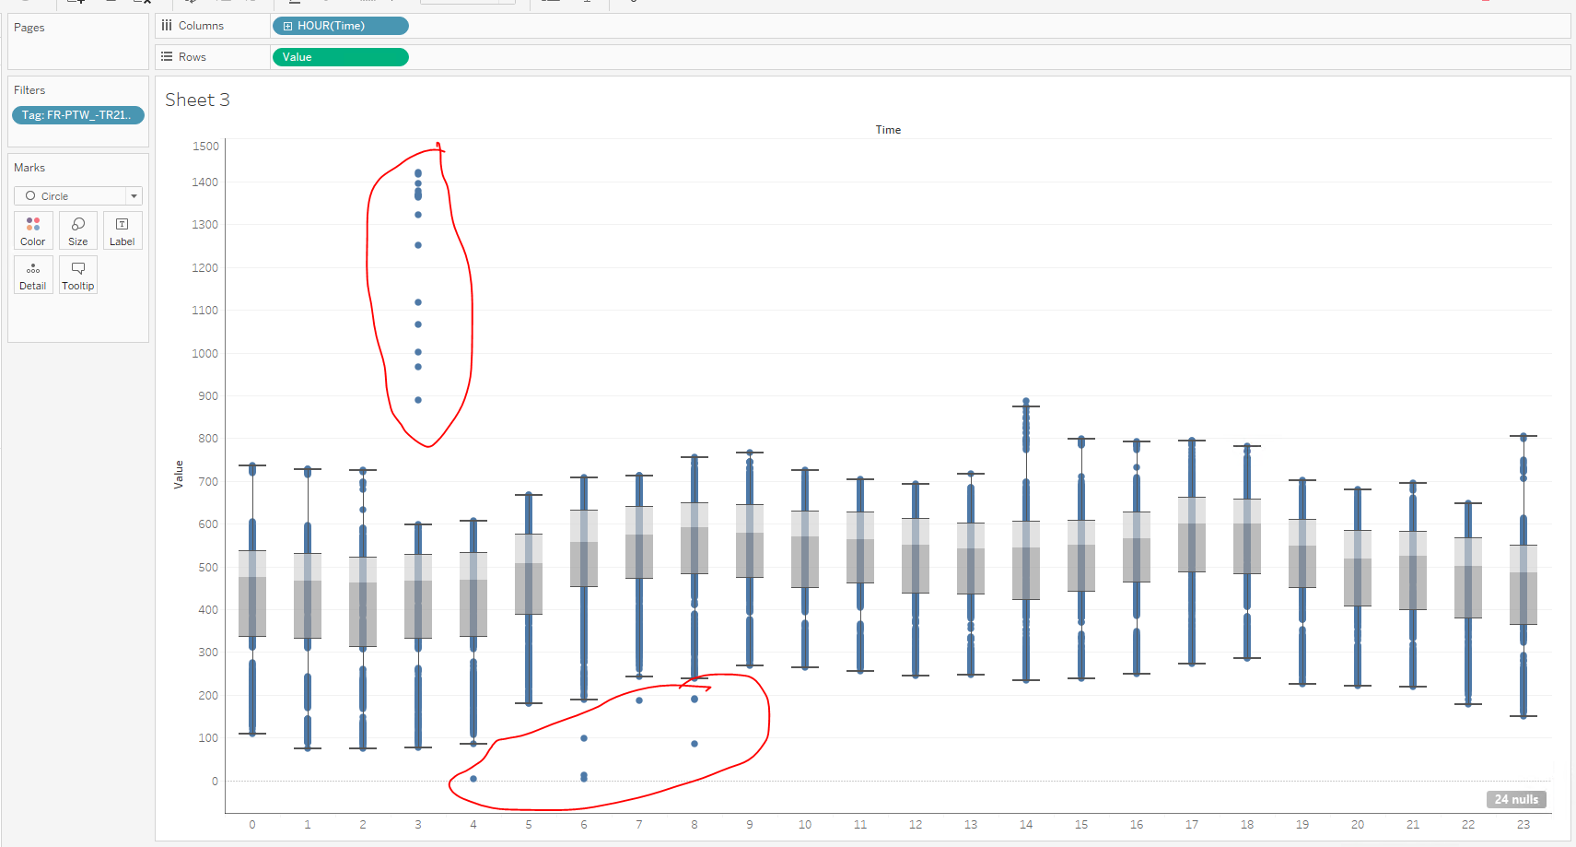
Data Analytics (Tableau)
Using data extracts via PI OLEDB. Visualizing the data with Tableau or experimenting with Microsoft Azure Machine Learning Studio by apply existing algorithms.

Slide 12
How this will help f
A connected system provides a better overview and enables a seamless workflow by having systems integrated
Using existing powerfull tools to prevent implementation of things that already exists (e.g. Cortana Intelligence Gallery)
Enabling data exploration by using Tableau for vizualisation
Interaction with the system in new way (Alexa)
Saving costs predicting events faster and assigning field forces at the right time

Slide 13
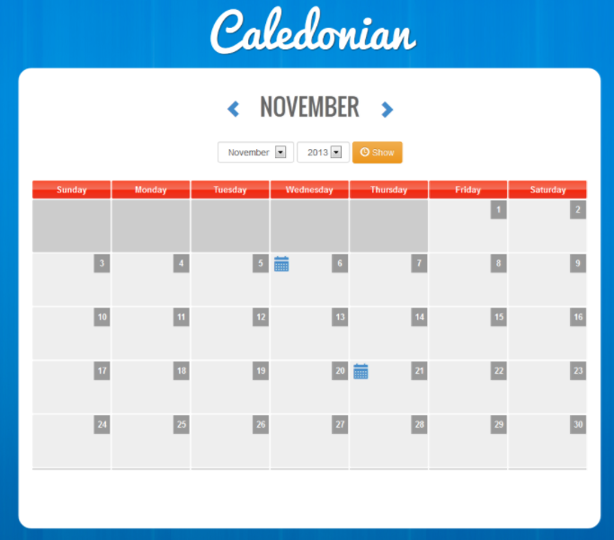
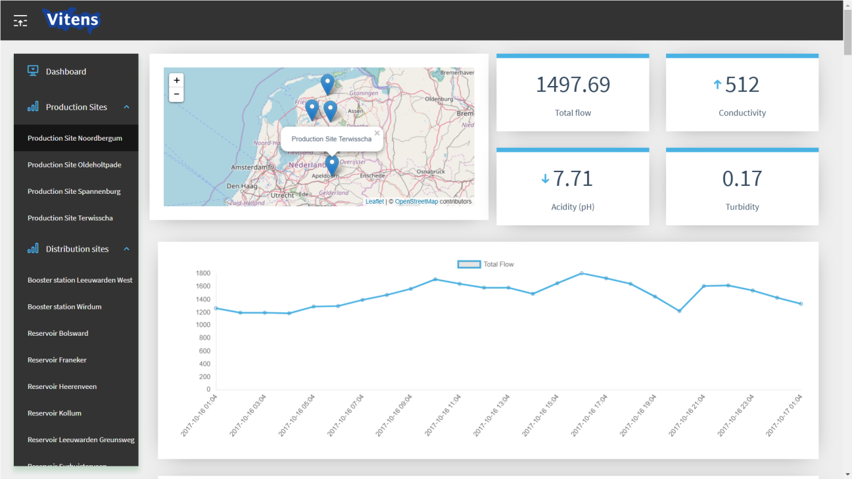
Last minute idea
+
By categorizing issues / anomalies not just to operative events but public events too (e.g. football, vacation) is it possible to predict data anomalies by just checking the calendar?

Slide 14
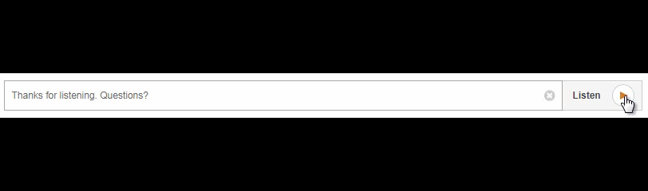
Thanks

Slide 15

E.ON Climate & Renewables - ConnectPoint
E.ON is an international, privately-owned energy supplier focused on 3 areas:
Renewables
Energy networks
Customer solutions
It operates in over 30 countries and serves over 33 million customers.
The Company employs above 50 000 people world-wide and annually achieves revenues above 100 billions Euro
E.ON Climate & Renewables (EC&R), headquartered in Essen, Germany, is responsible for E.ON’s industrial-scale renewable energy activities.
EC&R develops, builds and operates large renewable energy assets in Europe and North America.
ConnectPoint is a Software vendor and System Integrator specialized in Utilities & Industry sector
The company is present in Poland and Germany with the team of experienced professional in IT/OT integration and SW development
ConnectPoint started co-operation with E.ON Climate & Renewables in 2013 and since that time the company conducted above 20 projects in areas like
Custom Software development
System Integration in IT/OT area
Business Intelligence applications development (e.g. OSIsoft PI)

Slide 16

Find out more.
If you would like to find out more about how ConnectPoint can help transform your utility service with intelligent network capability, get in touch with konrad.kazmierowski@connectpoint.pl

